Slide 1
ISR Systems
First Article Inspection
Per AS9102
Training

Slide 2
First Article Inspection
Requirements
AS9102 Rev A - Aerospace First Article Inspection Requirement
Invoked by AS9100:
7.5.1.1 Production Process Verification
The organization shall use a representative item from the first production run of a new part or assembly to verify
that the production processes, production documentation and tooling are capable of producing parts and assemblies that meet requirements. This process shall be repeated when changes occur that invalidate the original results (e.g., engineering changes, manufacturing process changes, tooling changes).
NOTE This activity is often referred to as first article inspection.
NOTE: See (AS) (EN) (SJAC) 9102 for guidance

Slide 3
First Article Inspection
DEFINITION
FIRST ARTICLE INSPECTION (FAI):
A complete, independent, and documented physical and
functional inspection process to verify that prescribed production methods have produced an acceptable item as specified by engineering drawings, planning, purchase order, engineering specifications, and/or other applicable design documents.
Ref AS9102 Rev A

Slide 4
First Article Inspection
Purpose
Provides objective evidence that:
All engineering design and specification requirements are
  understood
  accounted for
  verified
  and documented
i.e. Process and Manufacturing validation

Slide 5
First Article Inspection
When should FAI be performed?
Full FAI
  New part introduction
  New supplier or new location of manufacture
  Lapse in production for more than 2 years
  When required by the customer or Goodrich ISR
Partial (Delta) FAI
  Design change
  Significant change in the method of manufacture (e.g. Tooling, Processes, Machine, Location, Numerical Control Program, Sequence of Manufacture).
  Refer to Supplier Quality Manual for complete listing.

Slide 6
First Article Inspection
What does it apply to?
All parts defined by drawings issued by ISR
Assemblies
All levels of detail parts within assembly
  including castings and forgings
Modified Standard, Electronic or COTS Items
  Only the modifications

Slide 7
First Article Inspection
What does it not apply to?
Standard Parts
  If supplier can provide evidence (CofC) that part has been qualified to procurement specification such as MS, NAS etc.
Electronic Components
  If parts being supplied have been manufactured by a supplier listed on Qualified Products List (QPL) for that part
  Non Custom parts (COTS)
Commercial Off The Shelf (COTS) Items
No FAI required

Slide 8
First Article Inspection
What is included?
Verification of all design characteristics
Material and Special Process Certifications
Manufacturing Process Verification
Nonconformance resolution
FAIRs for major subassemblies

Slide 9
First Article Inspection
Forms
The Following Forms comprise a First Article Inspection Report (FAIR)
AS9102 Form 1: Part Number Accountability shall be used to identify the part that is being first article inspected (FAI part) and associated sub-assemblies or detail parts.
AS9102 Form 2: Product Accountability – Raw Material, Specifications and Special Process(s), Test Verification shall be used if any material, special processes or functional testing are defined as a design requirement.
AS9102 Form 3: Characteristic Accountability, Verification and Compatibility Evaluation shall be used to record an actual measurement or inspection/verification of the FAI part for every design characteristic on the drawing, including notes.
Note: The standard Form 3 in this tutorial has been modified to include a column for the recording of measurement equipment used during the inspection of the FAI part.

Slide 10
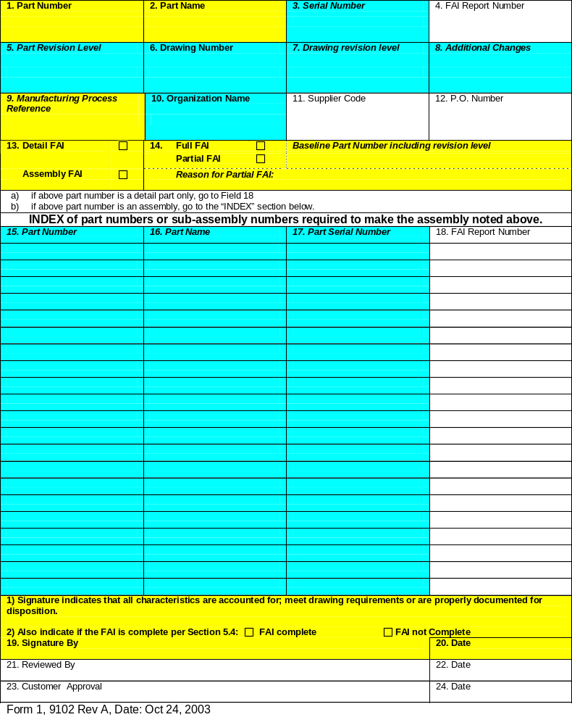
AS9102 Form 1 – Part Number Accountability
YELLOW or LIGHT GREY fields – MANDATORY information required.
BLUE or DARK GREY fields – CONDITIONALLY REQUIRED. These fields must be completed when information is available.
WHITE fields – OPTIONAL information required when available.

Slide 11
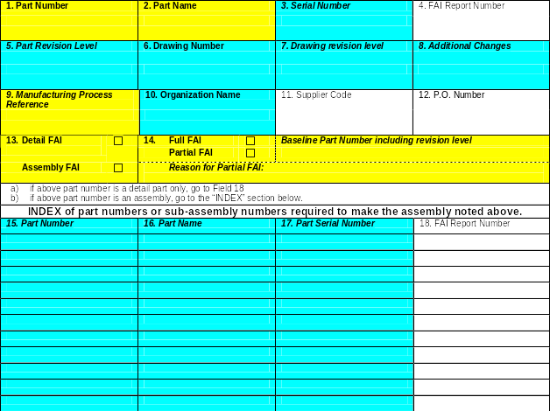
AS9102 Form 1 – Part Number Accountability
Box 1. Part Number of the FAI part.
Box 2. Name of the part as shown on the drawing.
Box 3. Serial number of the FAI part.
Box 4. The Report No.
Box 5. The revision of the part being first article inspected. Indicate if there is no revision.
Note: The latest revision (Box 7) does not always affect all parts contained on a drawing.
Box 6. The drawing number associated with the FAI part.
(if different from part number)
Box 7. Reference the revision engineering drawing.
(if drawing number is different from part number)
Box 8. Reference ECO or VMRR authorized changes affecting the FAI part, not reflected by the current part/drawing revision level.

Slide 12
AS9102 Form 1 – Part Number Accountability
Box 9. Reference internal manufacturing process and Rev used.
Box 10. Name of the organization performing the FAI .
Box 11. Reference the supplier vendor code.
Box 12. Reference the customer Purchase Order number.
Box 13. Check as appropriate.
Box 14. Check as appropriate. For Partial FAI provide the baseline drawing number, including issue status and the reason. i.e Change of manufacturing location,
Non-Conformance, Process change, Design change etc.

Slide 13
AS9102 Form 1 – Part Number Accountability
Boxes 15, 16, 17 and 18 – this section is only required if the Part Number in Box 1. is an Assembly with lower level parts.
Box 15. Reference all lower level parts or
next level sub-assembly Part Number.
Box 16. Part name as shown on the drawing/ parts list.
Box 17. Reference the serial number of the part.
Box 18. A reference number that identifies the FAI package.

Slide 14
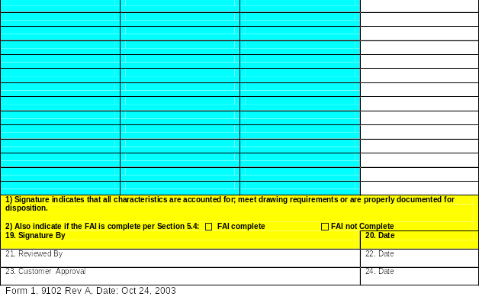
AS9102 Form 1 – Part Number Accountability
Box 19. The name and signature of the person who prepared the FAI.
Box 20. Date when the FAI was prepared.
Box 21. The name of the person who reviewed or approved the FAI package.
Box 22. Date when the FAI was reviewed.
Box 23. Customer Approval.
Box 24. Date of Customer approval.

Slide 15
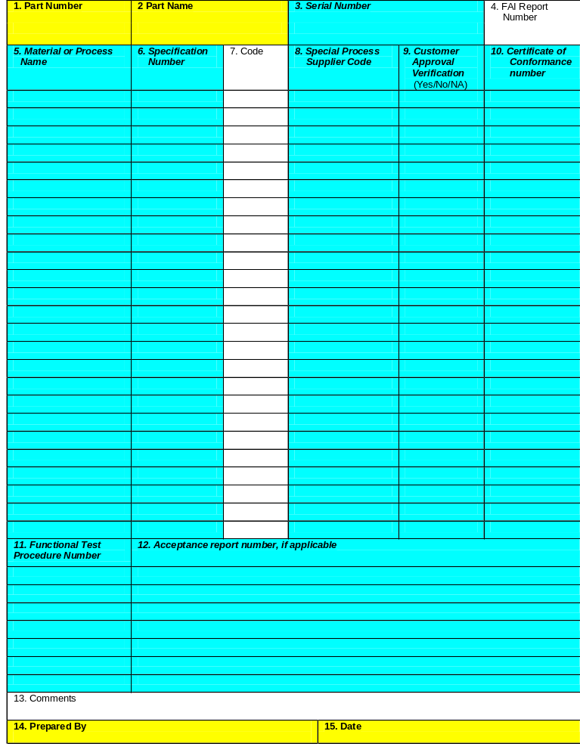
AS9102 Form 2 – Product Accountability
Boxes 1 - 4 are repeated on all forms for convenience and traceability.

Slide 16
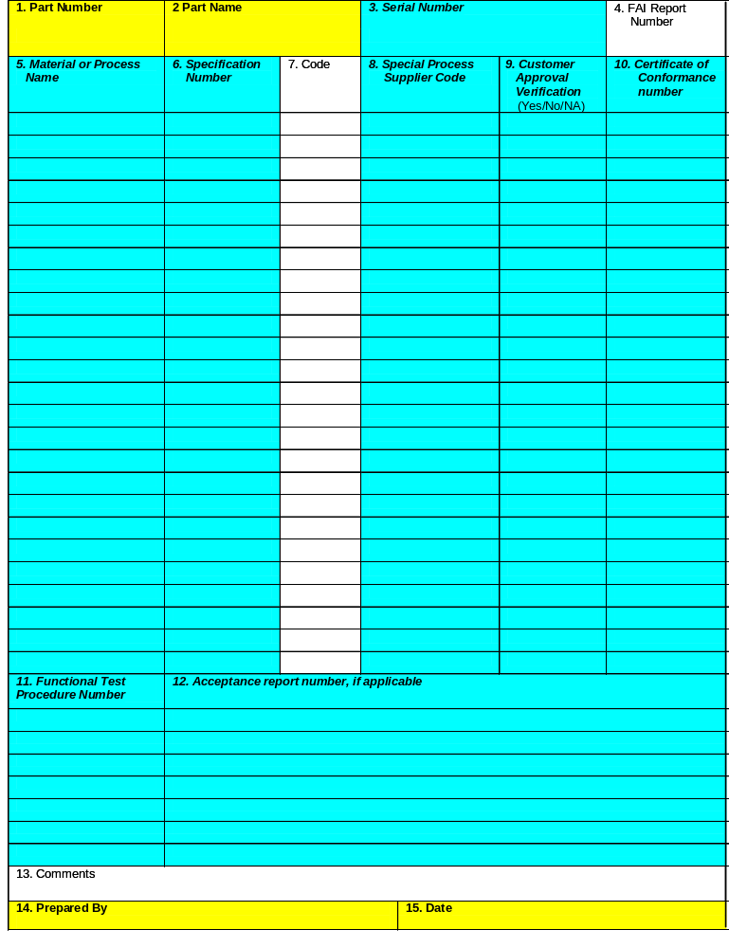
AS9102 Form 2 – Product Accountability
Box 5. Enter the name of the material or process i.e. Aluminium Alloy, Cadmium Plate etc.
Box 6. Enter the material or process specification number, class and material form i.e. AMS4928 Bar (Include ‘make from’ materials, weld/ braze filler materials, standard catalogue hardware etc).
Box 7. Reference any material code specified.
Box 8. Reference Special Process Supplier Vendor code.
Box 9. Indicate if technical approval is required by the customer.
Box 10. Reference Certificate of Conformance number(s) e.g. Special Process, Raw material & Mill certifications, Laboratory Reports etc.

Slide 17
AS9102 Form 2 – Product Accountability
Box 11. Reference the Functional Test procedure
as stated on the drawing.
Box 12. Reference the Functional Test report.
Box 13. Comments – As applicable.
Box 14. The name of the person who prepared this form.
Box 15. Date when this form was completed.

Slide 18
BALLOONED DRAWING
A ballooned drawing is a required element of a FAIR package to support Box 5 of Form 3
Identify 100% of contracted* characteristics:
Balloon and number all dimensions
Balloon and number all surface finish callouts
  Including exclusion and inclusion area callouts
Balloon and number all material and hardness callouts
  Don’t forget the requirements identified in the title boxes at the bottom of the drawings.
Note callouts are identified as such on Form 3 e.g. Note1, Note 2 etc.
*If part is shipped incomplete per the Purchase Order(PO), Statement Of Work(SOW) or approved Vendor Material Review Request(VMRR) account for the excluded characteristics by indicating in balloon or adjacent to note the coded reason.
PO
SOW
VMRR#XXXX

Slide 19
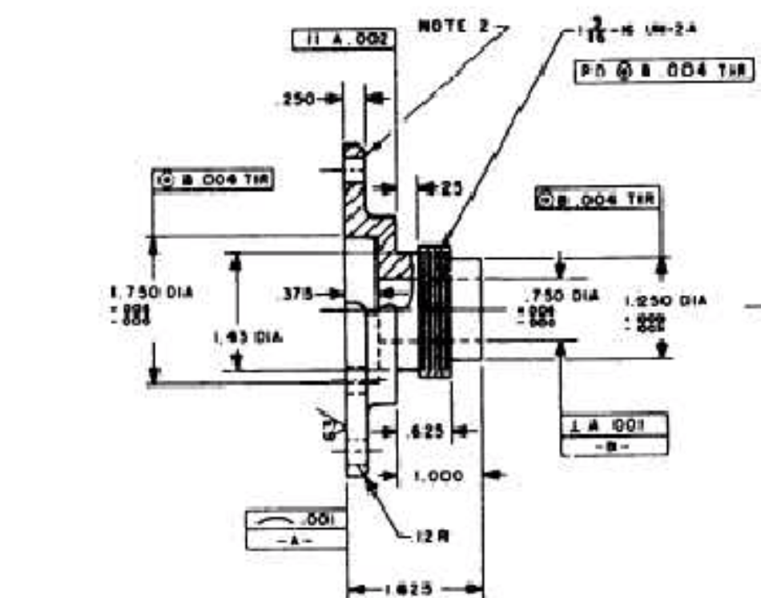
BALLOONED DRAWING
Note 2
1
2
3
8
4
7
5
6
Note: In this example not all characteristics ballooned

Slide 20
BALLOONED DRAWING
Circuit Card Assemblies
Balloon and number all drawing features including dimensions, specifications and literary notes.
Discrete electronic components (or detail parts) are accounted for by color highlighting the reference designator as follows:
1.Component in place and part number/value/polarity visually verified – Green
2.Component in place and not able to visually verify part number/ value/polarity – Yellow
3.Component purposely not installed – Red
Indicate reason by reference designator on the field of drawing or separate attached listing, also reference authorizing document e.g. PO, SOW or VMRR#.
4.No component to be installed at reference designator by design (not on parts list) – Blue
Include the color code legend on the field of the drawing.

Slide 21
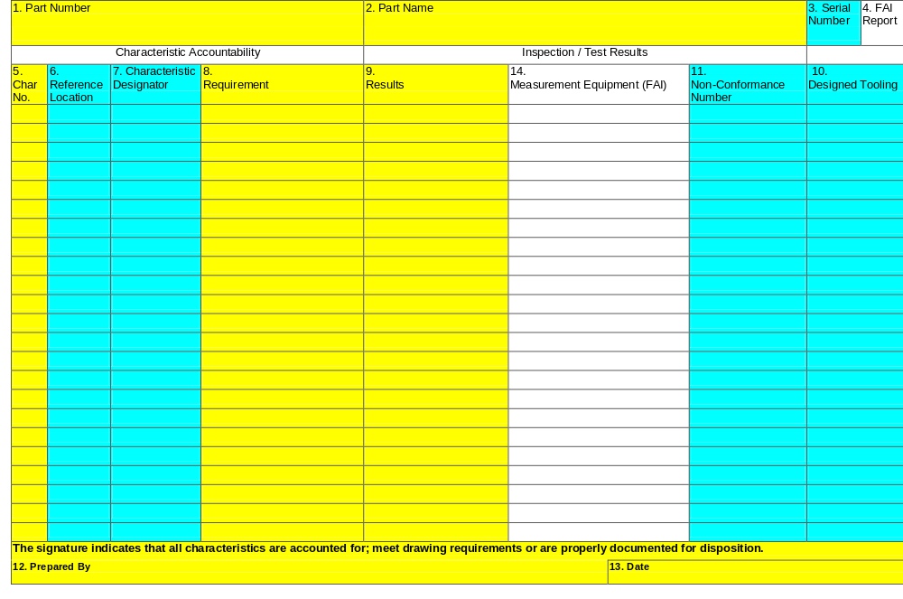
AS9102 Form 3 – Characteristic Accountability Verification and Compatibility Evaluation
Boxes 1 - 4 are repeated on all forms for convenience and traceability.

Slide 22
AS9102 Form 3 – Characteristic Accountability,
Verification and Compatibility Evaluation
Box 5. Assign a unique number for each design characteristic. In most cases this identifier is from the ballooned drawing.
Box 6. Reference the drawing zone (include Sheet No. and Section).
Box 7. Reference any zoned characteristics i.e. Key Characteristics, Sealed features, Datum features etc.

Slide 23
AS9102 Form 3 – Characteristic Accountability,
Verification and Compatibility Evaluation
Box 8. Indicate the specified requirement for the design characteristic i.e. Dimensional features with minimum and maximum value of tolerance, Drawing notes, Specification requirements etc.

Slide 24
AS9102 Form 3 – Characteristic Accountability,
Verification and Compatibility Evaluation
Box 9.
Indicate measurements obtained for each design characteristic. Multiple characteristics shall be listed as individual values.
All drawing notes must be accounted for.
Processes that require design verification must have statement of compliance recorded on the form i.e. Certification of Compliance – state ‘Accept’.
Laboratory reports or Certificate of test must show specific values for requirements and actual results.

Slide 25
AS9102 Form 3 – Characteristic Accountability,
Verification and Compatibility Evaluation
Box 14. Reference measurement equipment used for FAI.
(Note: The standard Form 3 in this tutorial has been modified to include a column for the recording of measurement equipment used during the inspection of the FAI part and is required only if requested. )
Box 11. Record non-conformance document reference number if any design characteristic is found non-conforming.
Box 10. Record the tool identification number of specially designed tooling used as a media of inspection.

Slide 26
AS9102 Form 3 – Characteristic Accountability,
Verification and Compatibility Evaluation
Box 12. Name of the person who prepared this form.
Box 13. Date when this form was completed.

Slide 27
First Article Inspection
Forms cont’d
AS9102 forms can be downloaded at:
http://www.sae.org/aaqg/publications/as9102a-faq.htm

Slide 28
First Article Inspection
FAI Completion & Verification
  Results compiled by person independent to process
  Results reviewed independently and signed
ISR Acceptance
  Submitted FAI Report and Part are verified by ISR personnel.
  Results are fed back to supplier
    If acceptable, signed sheets sent to Supplier for the record.
    If unacceptable, processed via Non-Conforming Material procedure.

